Slide 1

DBNet – Status and Plans
On behalf of DBNet Coordination Group
Chairman: Pascal Brunel, Meteo-France
GODEX-NWP, 16-19 May 2017

Slide 2
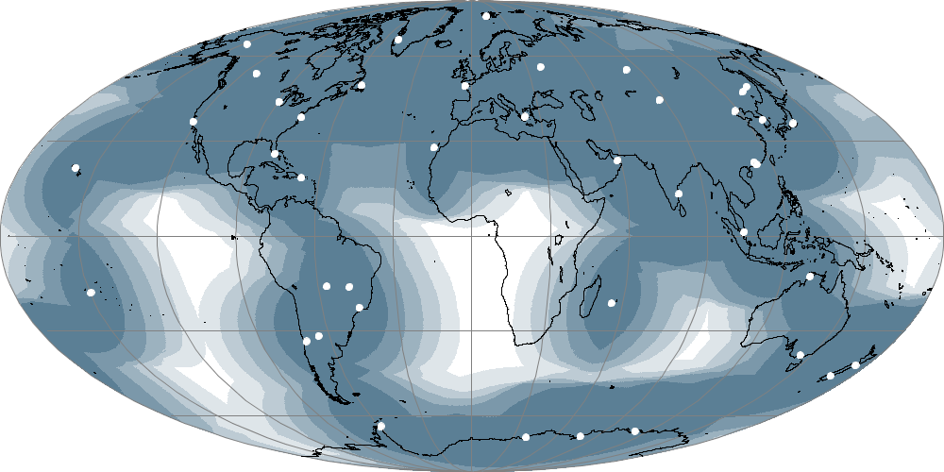
DBNet concept and objectives
Global availability of near real-time LEO data received by a collection of Direct Broadcast stations distributed around the world
Ensuring global consistency by using common software (i.e. AAPP), standardized coding and file naming, and quality monitoring
Dissemination by the WMO Information System (primarily GTS)
Coordinated by WMO Space Programme
Initial goal established:
NOAA and Metop ATOVS (L1b)
from 90% of the globe
available on the GTS in 30 min
Status August 2016
ATOVS= HIRS, AMSU-A, AMSU-B, MHS

Slide 3
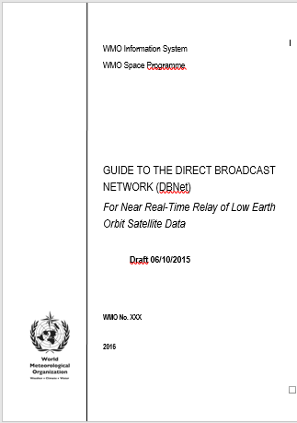
DBNet Components
DBNet is composed of regional networks coordinated by regional or sub-regional nodes and a global DBNet Coordination Group
Global monitoring of product consistency is performed by the NWPSAF (http://nwpsaf.eu/site/monitoring/dbnet/)
Regional Network | Regional or Sub-regional Node
DBNet - EUMETSAT | EUMETSAT
DBNet - Asia-Pacific | JMA
 | BoM
DBNet - South America | INPE
 | SMN Argentina / CONAE
DBNet - NOAA | NOAA
Guide endorsed by WMO Commission for Basic Systems in Nov 2016

Slide 4
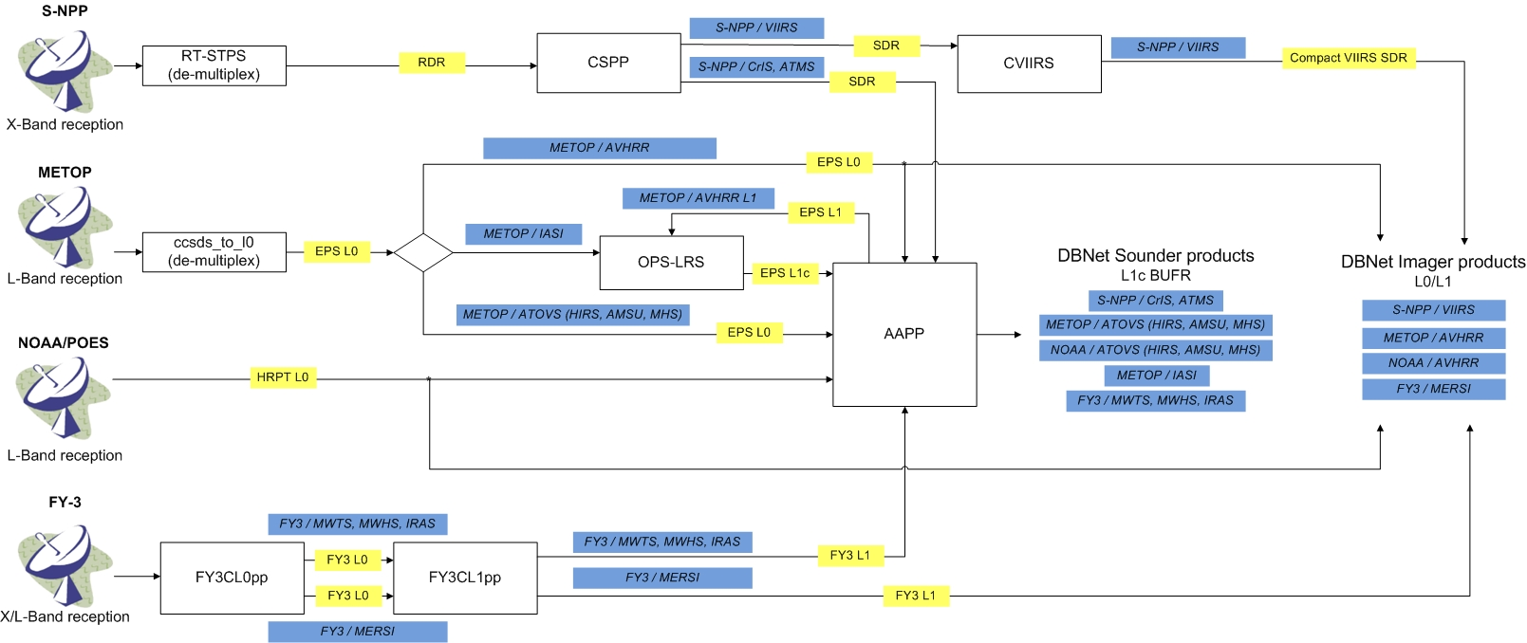
Common processing software suite and orbital elements for product consistency

Slide 5
Current and potential DBNet services
Each DBNet regional network contributes to one or more “Services”
A DBNet Service consists of Direct Broadcast acquisition, processing and relay of a category of satellite data
Categories of services | Services/Instruments
IR/MW sounding | ATOVS (AMSU-A, MHS, HIRS) ATMS, VASS (MWTS, MWHS, IRAS)
Hyperspectral IR sounding | CrIS, IASI, HIRAS
IR/VIS imaging | VIIRS, AVHRR, MERSI
Scatterometry | ASCAT
MW imagery | MWRI, AMSR-2, MTVZA-GY

Slide 6
DBNet High-Level Service Specifications
- To be reviewed when new WMO guidance for NWP is available
Category of Service | Driving Application | Products | Data latency goal/threshold | Availability | Coverage
IR/MW sounding | Global and High-Res NWP | Level 1 brightness temperatures | 20 min/ 30 min | 95% | 90%
IR/VIS imaging | Nowcasting | Level 1 radiance /reflectivity | 10 min/ 20 min | 95% | 30%
Hyperspectral IR sounding | Global and High-Res NWP | Level 1 radiances and PC scores | 20 min/ 30 min | 95% | 60%
Scatterometry | NWP, Nowcasting and Ocean applications | backscatter cross-sections | 20 min/ 30 min | 95% | 50% (of oceanic areas)
MW imagery | NWP, Nowcasting, | Level 1 brightness temperatures | 20 min/ 30 min | 95% | 30%

Slide 7
DBNet Services Implementation Status
Categories of Services | Services (Instruments) | Operational (Sep 2016)
IR/MW sounding | ATOVS (AMSU-A, MHS, HIRS), ATMS, VASS (MWTS/2, MWHS/2, IRAS) | ATOVS (global), ATMS (EUM + NOAA), VASS (EUM)
IR/VIS imaging | VIIRS, AVHRR, MERSI | VIIRS and AVHRR (EUM)
Hyperspectral IR sounding | CrIS, IASI, HIRAS, AIRS | CrIS (EUM + NOAA) and IASI (EUM + NOAA)
Scatterometry | ASCAT, Wind RAD | ASCAT (EUM)
MW imagery | MWRI, MTVZA-GY, AMSR-2

Slide 8
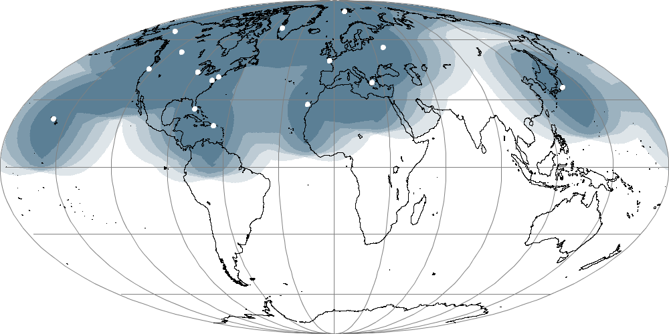
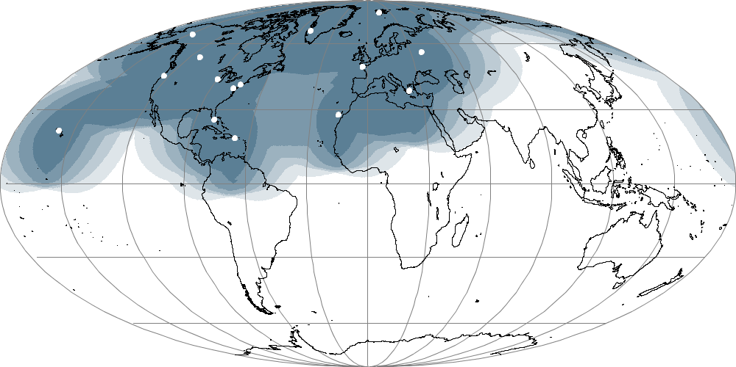
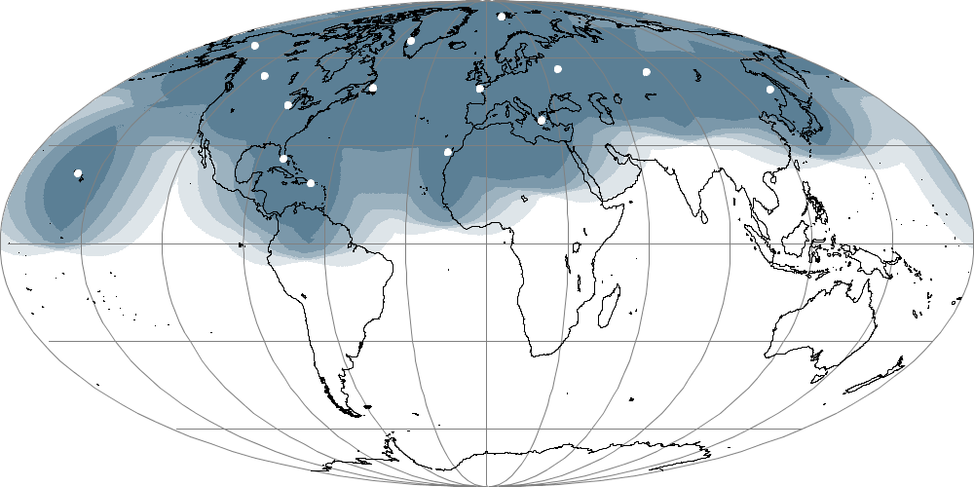
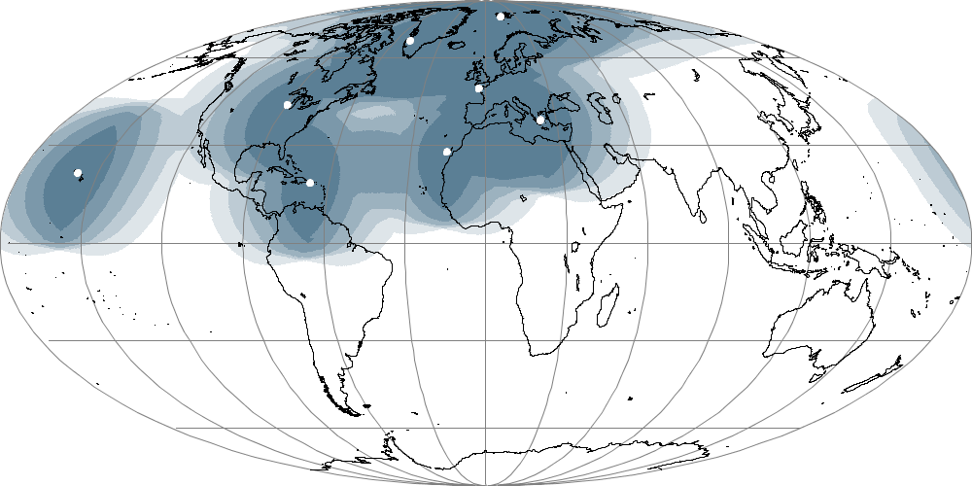
DBNet Coverage August 2016
ATOVS
ATMS
CrIS
IASI
VASS (FY-3)
IASI from KMA since 10 Feb 2017

Slide 9
Satellite acquisition priorities (reviewed annually)
Satellite | Orbit and satellite status (D=descending, A=ascending) | Instrument health | Global data availability | Direct broadcast transmission | DBNet priority (H/M/L)
Suomi NPP | NOAA Prime Polar PM 1330A | Good | 1 dump per orbit | Good (X-band). | H
Metop-B | Primary AM service. 0930D | Good | Very good: Arctic and Antarctic dumps | Good (L-band) | H
NOAA-19 | Prime NOAA PM. Close to S-NPP 1400A/0200D | Good | 1 dump per orbit | Good (L-band) | H
NOAA-18 | Has drifted to an early morning orbit 1700A/0500D | Good. HIRS degraded | Some blind orbits | Good (L-band) | H
Metop-A | Same orbital plane as Metop-B 0930D | Good | 1 dump per orbit | Limited geographically due to radiation issues | M
NOAA-15 | Close to NOAA-18 0530D | Poor. AMSU-B and HIRS not working. AMSU-A is still useful. | Some blind orbits. Low priority in NESDIS L1 processing. | Poor signal strength (L-band), can only be received by large dishes | L
FY-3C | 1030D | MWTS-2 not working, MWHS-2 OK. | Significant delays | Good (L-band for sounders, X-band for MERSI) | L

Slide 10
Météo-France Lannion’s role concerning DBNet

Slide 11
Météo-France Lannion’s role concerning DBNet
IASI level 1 processing for local stations
Port of EUMETSAT operational software to Linux
AVHRR calibration
Satellite and data navigation
Instrument mapping
Imager cloud mask for imagers (AVHRR, VIIRS)

Slide 12
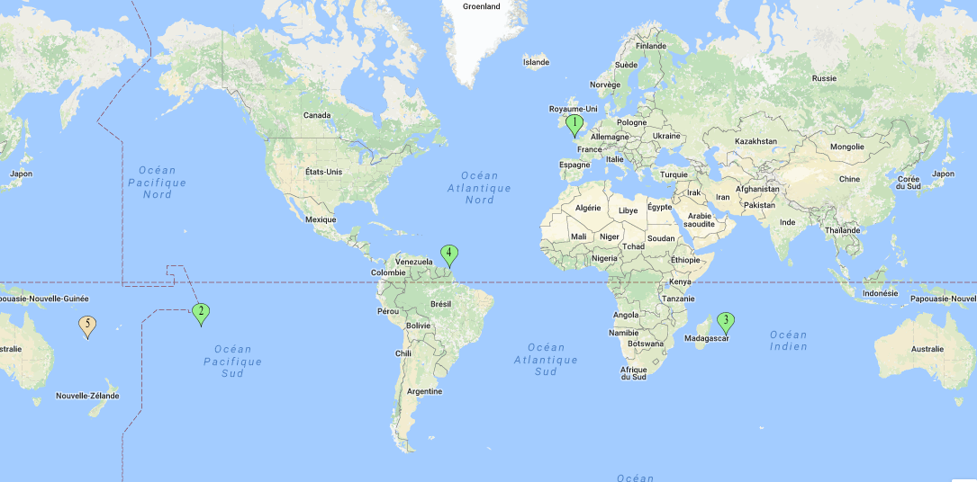
Météo-France Lannion’s role concerning DBNet
4 LEO stations around the world with L/X antennas all managed by CMS Lannion. May 2017
Lannion 2 antennas (via EUMETSAT)
Papeete
Saint Denis (via EUMETSAT)
Cayenne (no level 1 processing)
Nouméa under discussion

Slide 13
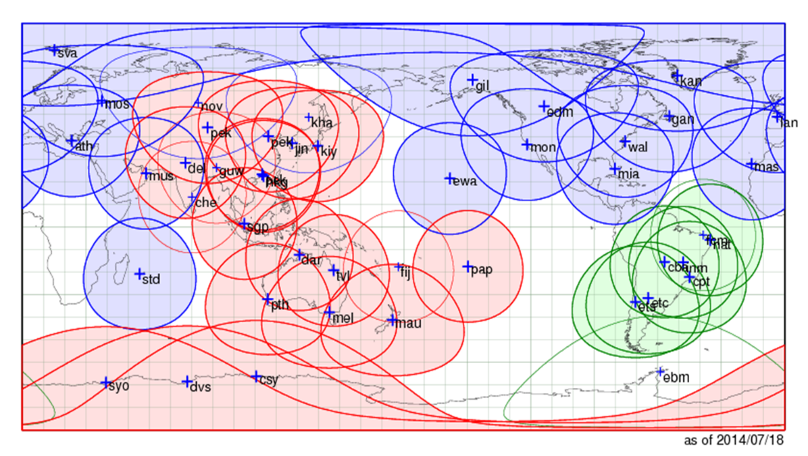
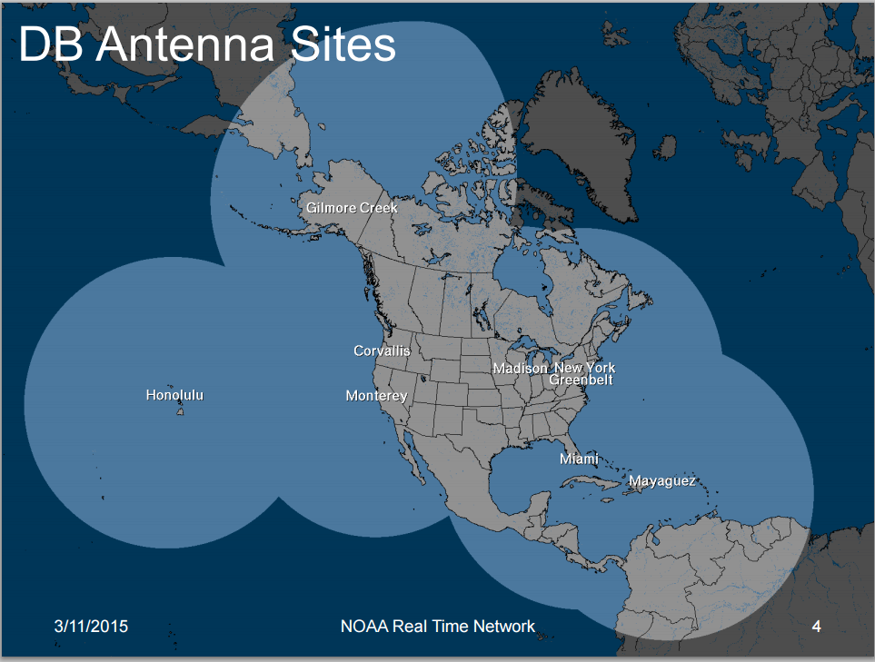
DBNet Coverage
Current network - Khabarovsk added in Sep 2016
New NOAA Real time Network was fully integrated in DBNet by end-2016 (pending GTS distribution)
Guam

Slide 14
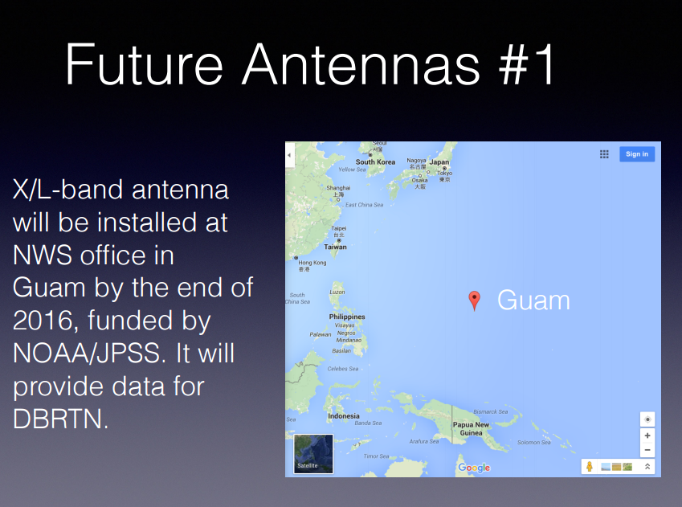
Coverage extension
Operational as of end-2016

Slide 15
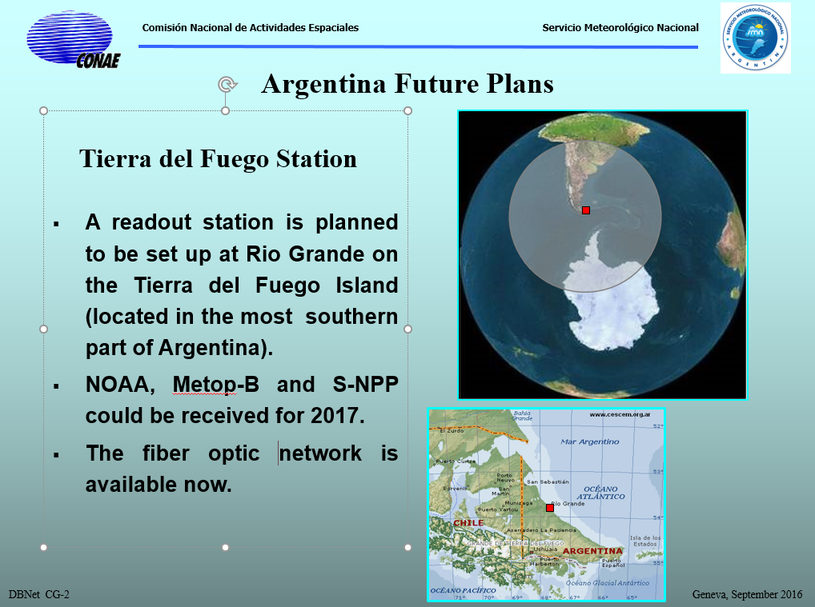
DBNet Coverage extension

Slide 16
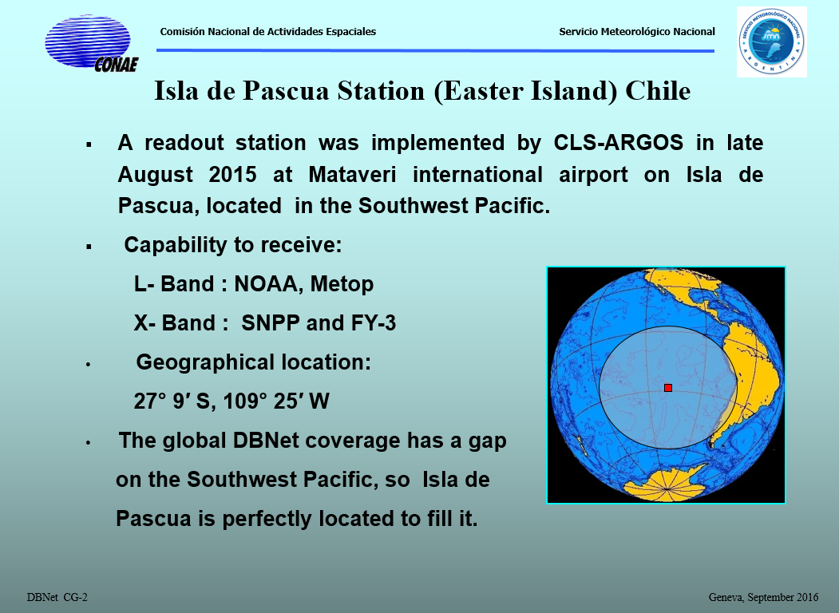
DBNet Coverage Extension

Slide 17
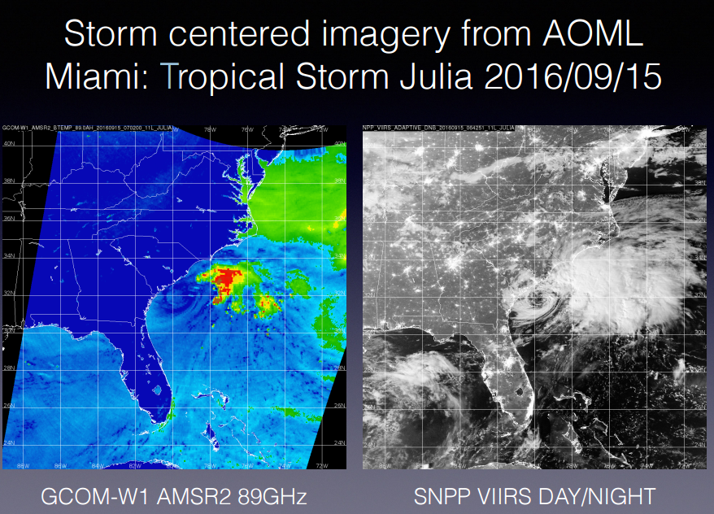
Non-NWP application: Hurricane data from DBNet
AMSR-2 and VIIRS delivered from DBNet antenna in Miami
DBNet processed ASCAT under consideration

Slide 18
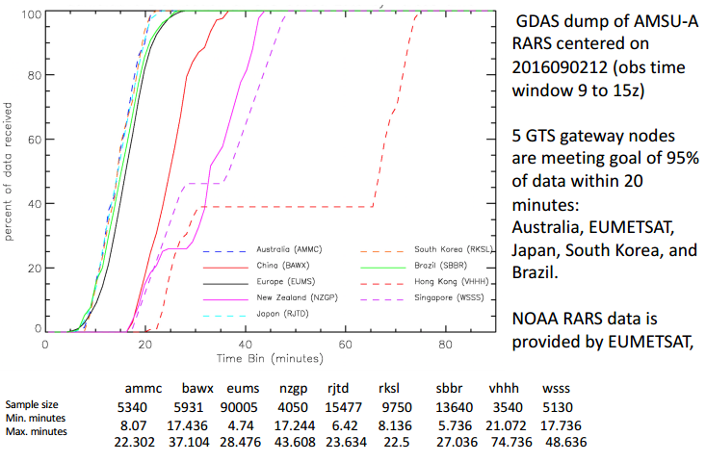
End-to-end timeliness: AMSU-A@NCEP

Slide 19
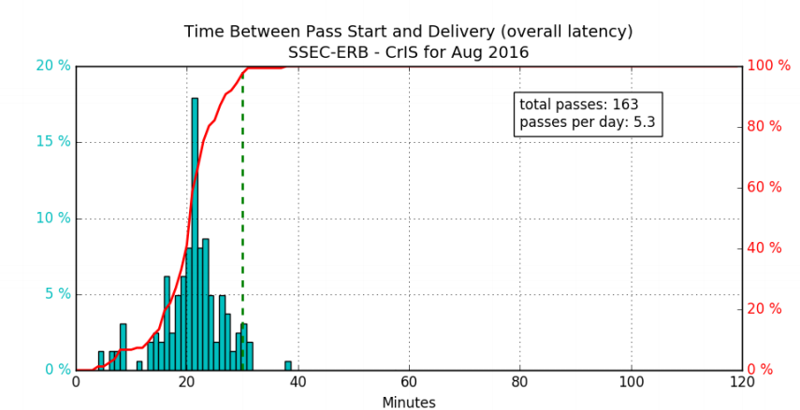
End-to-end timeliness: CrIS@NCEP

Slide 20
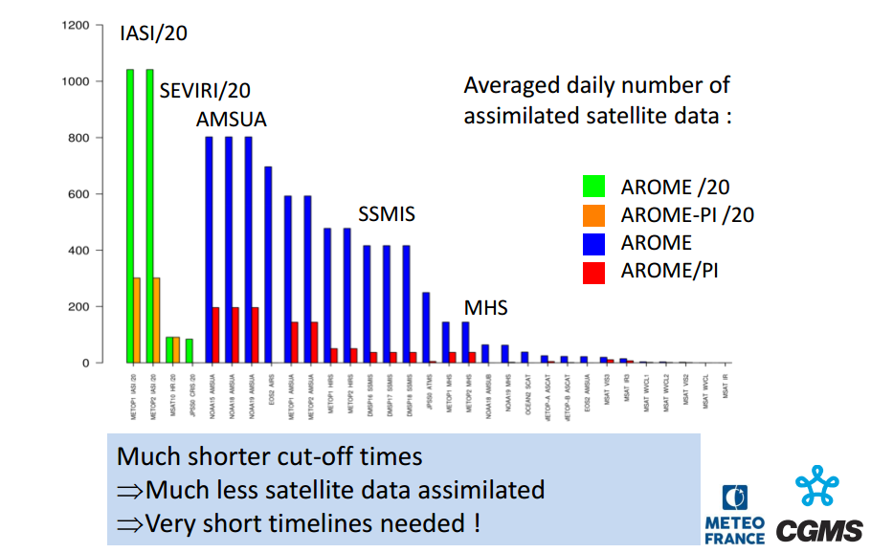
Challenge: Transition SRNWP -> Nowcasting NWP
Baseline SRNWP system with 1 hour cutoff
/PI is very short (10 min) cutoff system providing forecasters immediate analysis and very short term (6h) forecast
Alternative to radar image extrapolation
Challenge to future satellite data timeliness for GEO and LEO

Slide 21
Implementation challenges for new DBNet Services (IASI, CrIS, HIRAS)
High telecommunication impact
Requires trade-off and optimization
  Network design
  Operating mode
  Product contents
  GTS capacity planning
  Has to be addressed globally and regionally (Use optimized regional solutions where possible)
  Dialogue with capacity planning process still limited

Slide 22
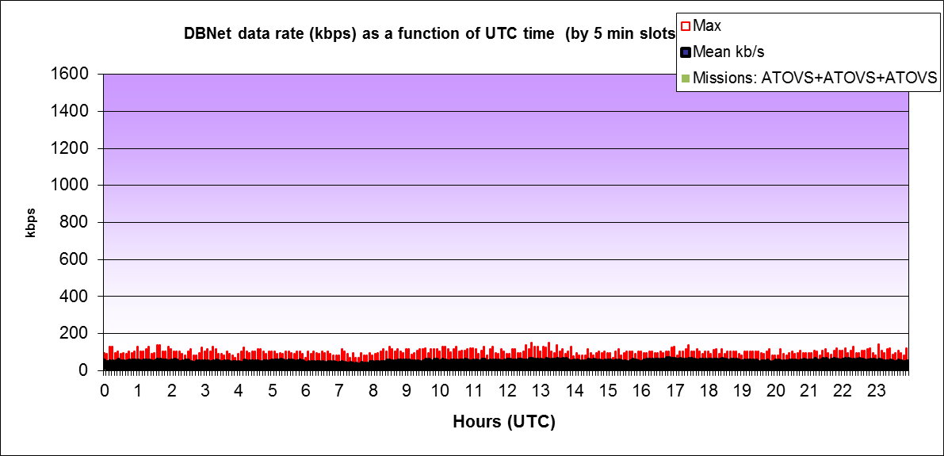
DBNet data traffic analysis:
Current data rates from 39 RARS/ ATOVS stations
39 active stations
Daily 560 MB
Peak 150 kbps
Mean 52 kbps

Slide 23
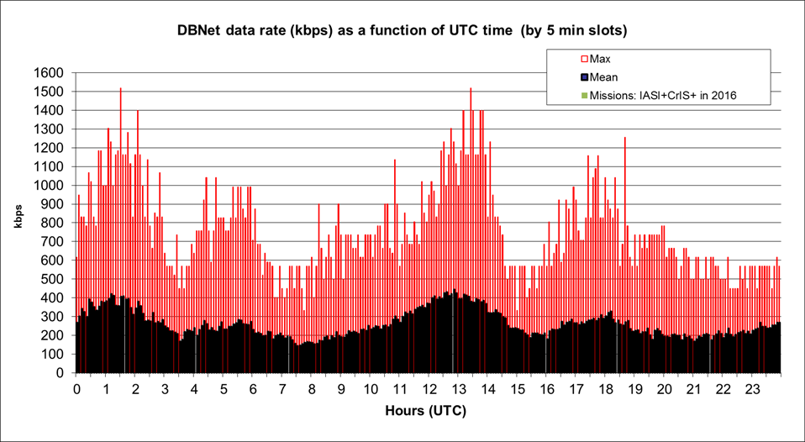
DBNet data traffic projection:
(1) 28 stations IASI-CrIS
28 stations
Peak 1517 kbps
Mean: 261 kbps

Slide 24
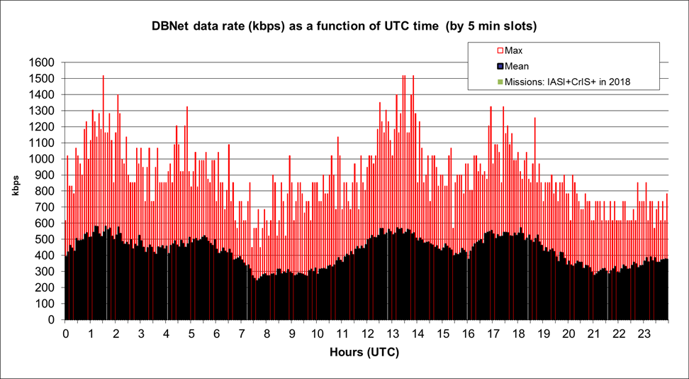
DBNet data traffic projection:
(2) 47 stations – IASI-CrIS
47 stations
Peak 1517 kbps
Mean: 425 kbps

Slide 25
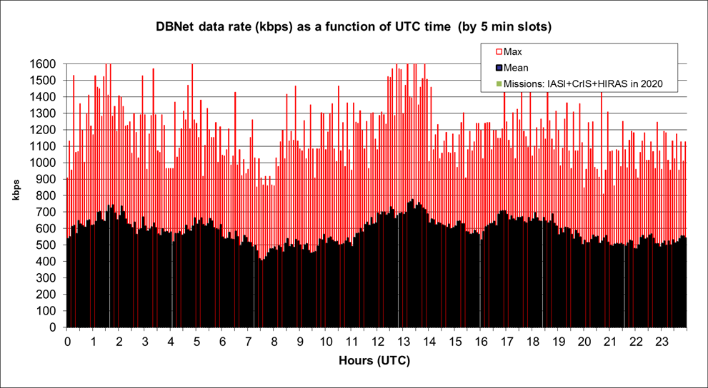
DBNet data traffic projection:
(3) 48 stations – IASI-CrIS-HIRAS
48 stations
Peak 1775 kbps
Mean: 588 kbps

Slide 26
High priority DBNet activities in the coming years
Consolidate the existing network for IR/MW sounding services, solving specific local problems
Complete the infrastructure for Metop and S-NPP/JPSS
Implement consistent monitoring of DBNet part of overall latency and address specific timeliness problems
Extend the geographical coverage of DBNet, capitalizing on existing capabilities (e.g. Tierra del Fuego, Isla de Pasqua, NW South America, Santa Maria Madre del Dios, Guam)
Improve the user-friendliness of release process for processing software
Advance the implementation of Hi-res IR services (IASI, CrIS)
Contribute to the implementation of the new WIS metadata standard for DBNet products
Strengthen the dialogue with global and regional WMO groups responsible for WIS capacity planning
Advance the implementation of FY-3

Slide 27
DBNet outlook
HIRAS
  FY-3 IR interferometer, to be launched on FY-3D in April 2017. Preprocessing software not yet available from China
FY-3E
  Planned for launch 2018-2019
  First full sounding suite in early morning orbit
  Implementation challenges due to use of LH circular polarization of downlink
African coverage
  EC-funded project for local processing in Africa. could be become part of DBNet
Microwave Imaging
  Relevant for regional NWP assimilation. Direct Broadcast available on FY-3/MWRI, GCOM-W1/AMSR-2, Meteor/MTVZA-GY
Radio occultation
  Space Weather community has expressed interest in very-low-latency data for ionospheric monitoring and Direct Broadcast available for RO instruments on Metop-SG and FY-3
  Could be provided by DBNet network, if fast processing is feasible

Slide 28
Thank you for your attention http://www.wmo.int/pages/prog/sat/dbnet_en.php
Acknowledgements
Nigel Atkinson, Anders Soerensen, Simon Elliott,
Mitch Goldberg, Liam Gumley, Denis Margetic,
Pascal Brunel, Hidehiko Murata, Gloria Pujol,
and the whole DBNet Coordination group
All DBNet station operators

Slide 29

Thank you
Merci

